Slide 1
Lecture 4: Control Statements – Part II
Dr. Tsung-Wei Huang
Department of Electrical and Computer Engineering
University of Utah, Salt Lake City, UT
Notes:
Morning everyone
Today we are looking into control flow part III in C++.

Slide 2
Learning Objectives
The essentials of counter-controlled repetition
Use for and do…while to execute statements
How to break and continue within the control flow

Slide 3
Counter-based Control Flow
Counter-controlled repetition requires
the name of a control variable (or loop counter)
the initial value of the control variable
the loop-continuation condition that tests for the final value of the control variable (i.e., whether looping should continue)
the increment (or decrement) by which the control variable is modified each time through the loop.
Notes:
So far, we have been covering the counter-based control flow. For example, we repeat the execution of statements for a couple of times. This require the ...

Slide 4
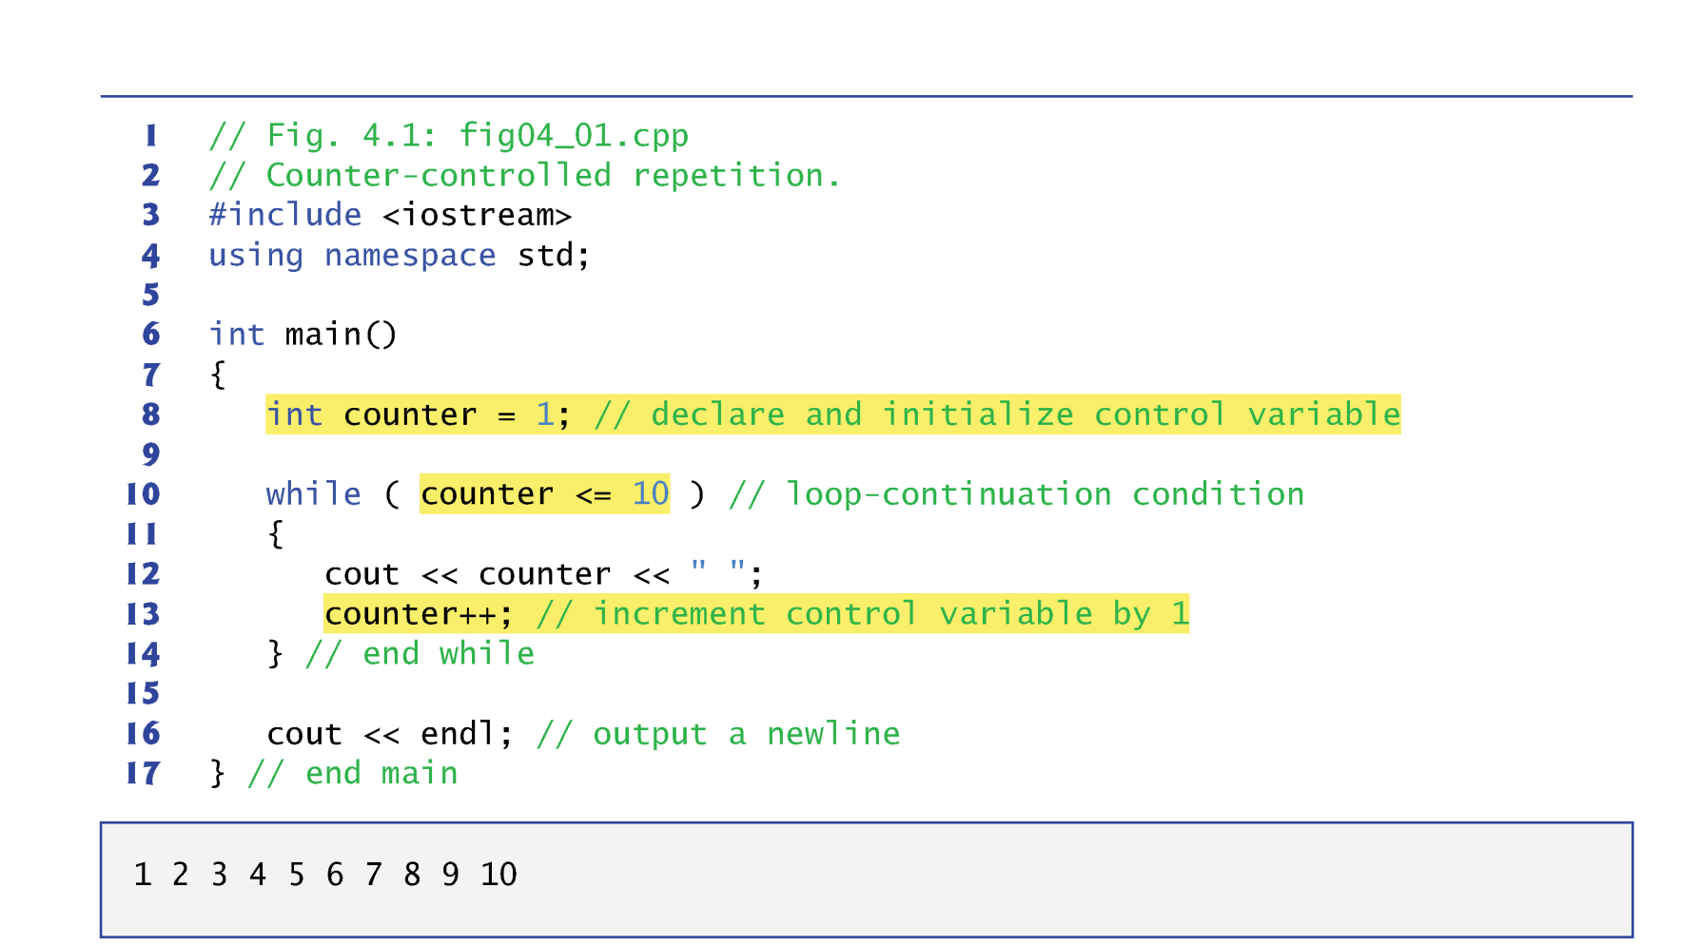
Revisit the Counter-based While Loop
Notes:
Here is an example we have been covering for a while. We start the counter from 1 and repeatedly printing the counter one by one until it becomes 10.

Slide 5
for Repetition Statement
The for repetition statement specifies the counter-controlled repetition details in a single line of code.
The initialization occurs once when the loop is encountered.
The condition is tested next and each time the body completes.
The body executes if the condition is true.
The increment occurs after the body executes.
Then, the condition is tested again.
If there is more than one statement in the body of the for, braces are required to enclose the body of the loop.
Notes:
In C++, there is another way to write this repetition statement. Instead of using while, we use for statement. It works as follow: The for repetition statement specifies ...

Slide 6
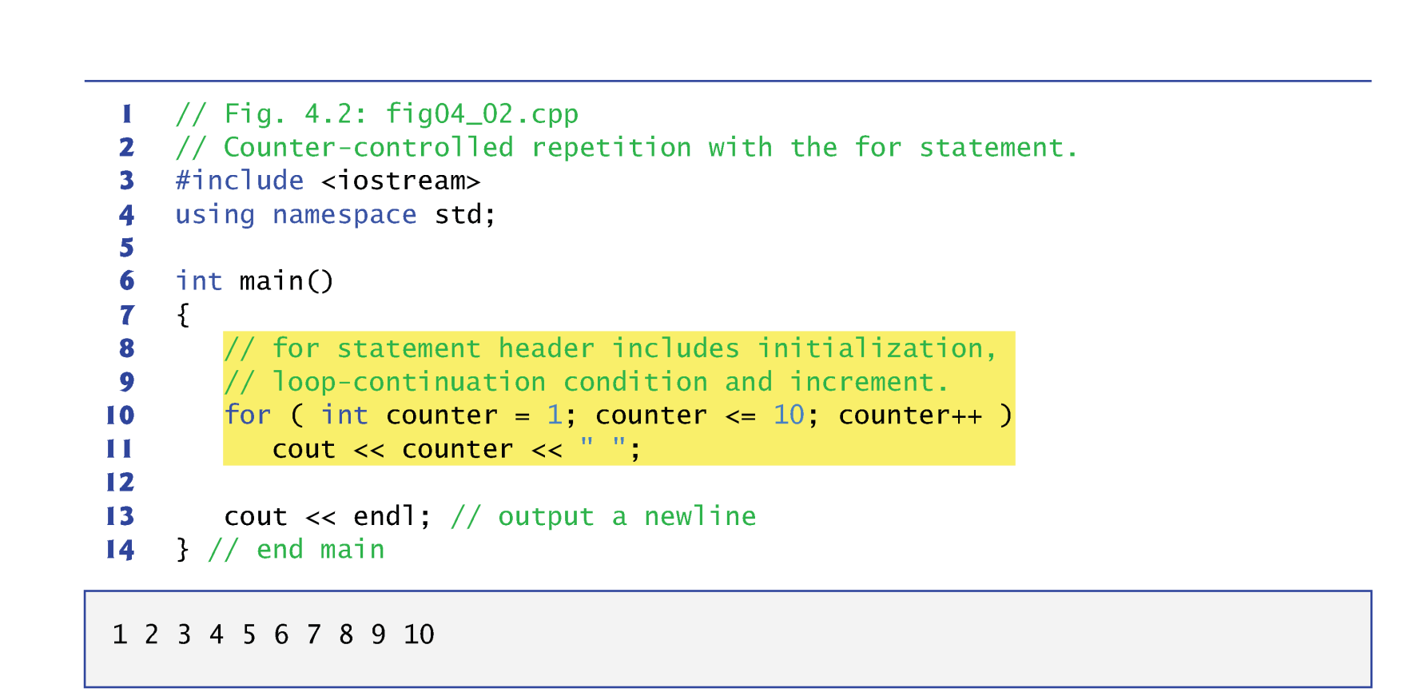
for Repetition Statement Example
Notes:
Let's take a look at the same example previously written in while but here written in for. a for statement includes three parts, initialization, loop-continuation condition, and increment. You put down all these three parts together in a single statement like this.

Slide 7
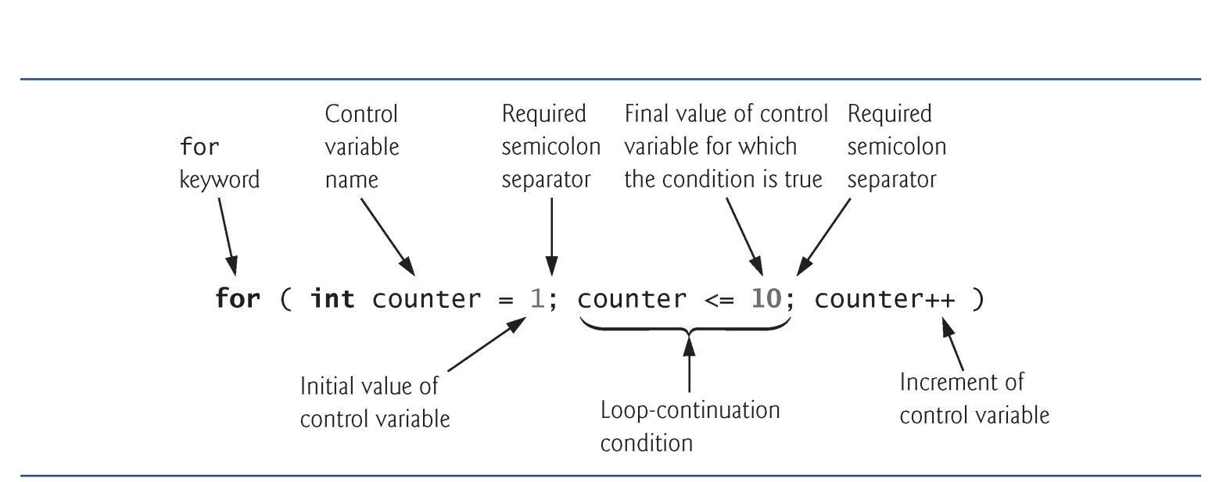
for Repetition Statement
Notes:
In a deeper look into the for, the statement is defined with several parts:

Slide 8
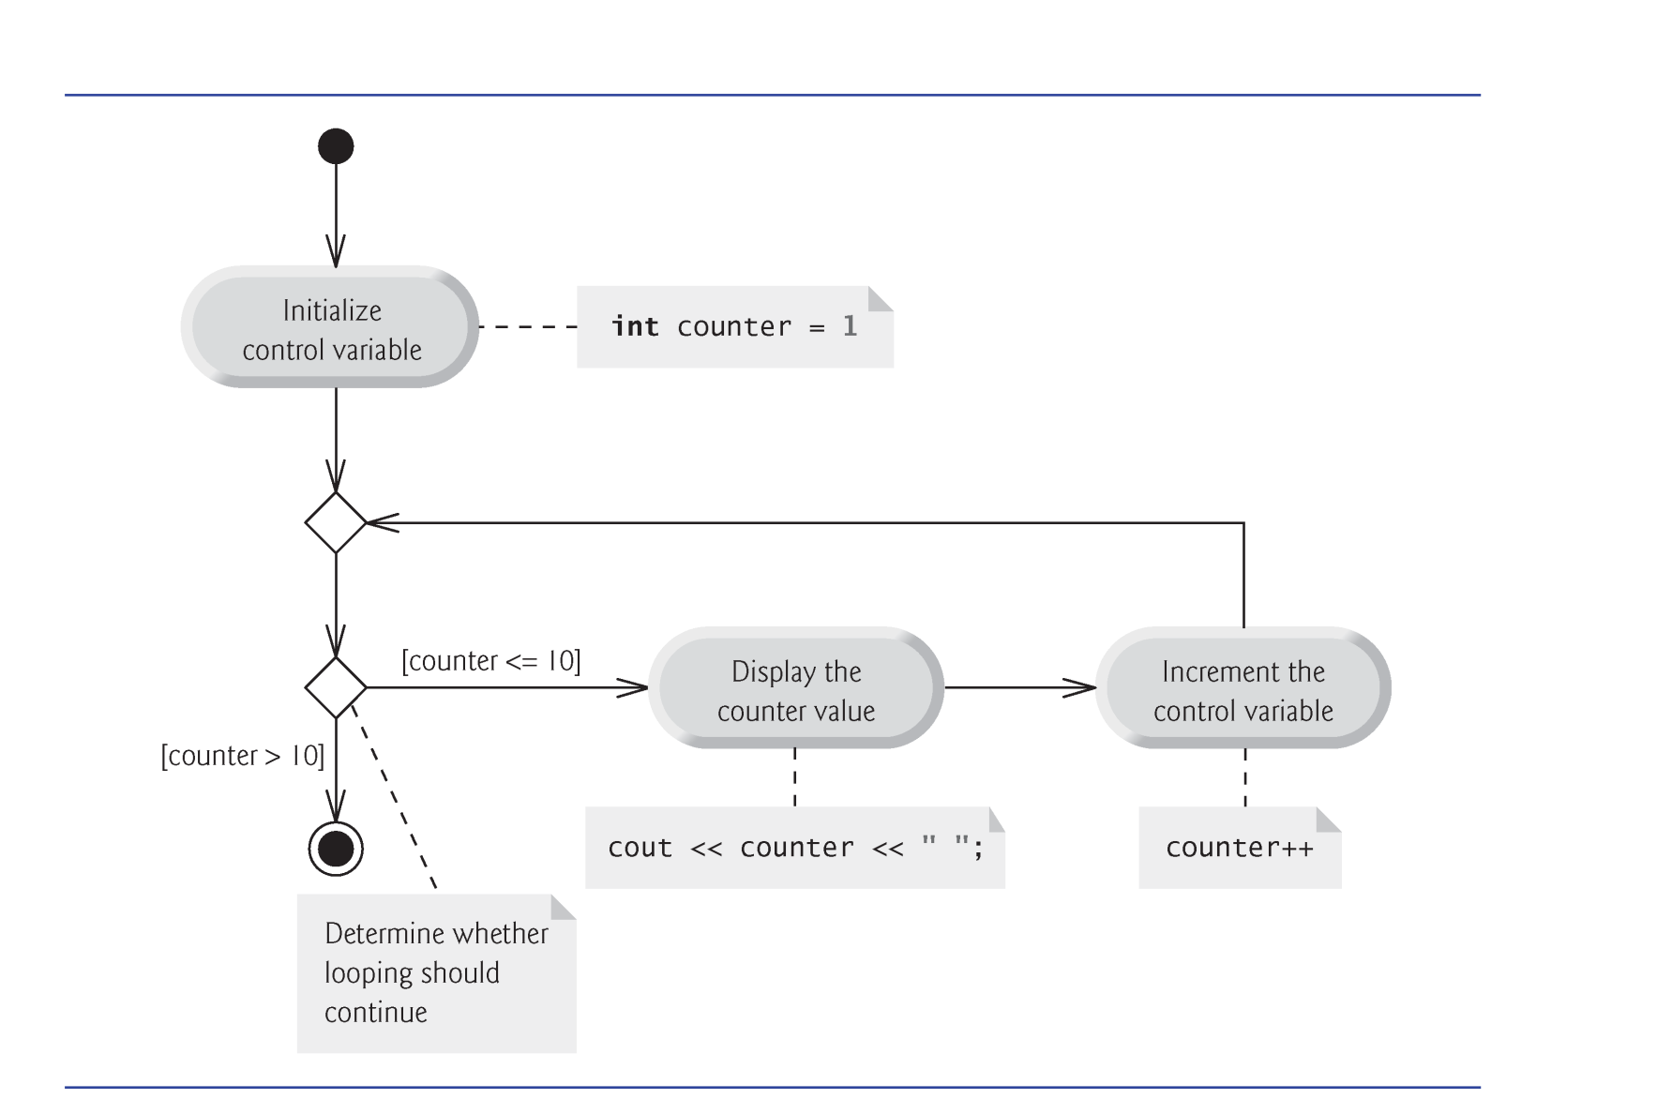
for Repetition Statement
Notes:
The diagram looks like this.

Slide 9
for vs while
The general form of the for statement is
for ( initialization; loopContinuationCondition; increment ) statement
where the initialization expression initializes the loop’s control variable, loopContinuationCondition determines whether the loop should continue executing and increment increments the control variable.
In most cases, the for statement can be represented by an equivalent while statement, as follows:
initialization; while ( loopContinuationCondition ) { statement increment; }
Notes:
For statement is very similar to while statement. Essentially, anything a while loop can express, the for loop statement can express it. Same for the other side, anything for loop statement can express, the while loop can make it. The general form of the for statement is …

Slide 10
Example: Rewrite while to for
int a = 2; while ( a < 10000 ) { a += (a % 2) ? 1 : 2; }
Notes:
Let’s do a practice

Slide 11
Increment a Counter
The initialization, loop-continuation condition and increment expressions of a for statement can contain arithmetic expressions.
The expressions
counter = counter + 1 counter += 1 ++counter counter++
are all equivalent in the incrementing portion of the for statement’s header (when no other code appears there).
The “increment” of a for statement can be negative, in which case the loop actually counts downward.
If the loop-continuation condition is initially false, the body of the for statement is not performed.
Notes:
Regardless of while loop or for loop, we always need a condition variable. This variable is frequently used as a counter. We use it to count the iteration, increment or decrement the counter to handle the iteration.

Slide 12
for Repetition Statement Pitfall!
for ( counter=1; counter<=10; counter++ ) ;
→ Do nothing for 10 times
for ( counter=1; counter<=10; counter++ ) {
}
→ Enclose your for loop statement with {}

Slide 13
Examples using for Repetition Statement
Vary the control variable from 1 to 100 in increments of 1.
for ( int i = 1; i <= 100; i++ )
Vary the control variable from 100 down to 1 in decrements of 1.
for ( int i = 100; i >= 1; i-- )
Vary the control variable from 7 to 77 in steps of 7.
for ( int i = 7; i <= 77; i += 7 )
Vary the control variable from 20 down to 2 in steps of -2.
for ( int i = 20; i >= 2; i -= 2 )
Vary the control variable over the following sequence of values: 2, 5, 8, 11, 14, 17.
for ( int i = 2; i <= 17; i += 3 )
Vary the control variable over the following sequence of values: 99, 88, 77, 66, 55.
for ( int i = 99; i >= 55; i -= 11 )

Slide 14
Example
What is the difference between the two statements?
for ( int c=10; c>=0; c-- ) ;
for ( unsigned c=10; c>=0; c-- ) ;

Slide 15
Example using for statement
A person invests $1000.00 in a savings account yielding 5 percent interest.
Use the following formula to calculate and print the amount of money in the account at the end of each year for 10 years: a = p ( 1 + r )^{n} where p is the original amount invested (i.e., the principal), r is the annual interest rate, n is the number of years and a is the amount on deposit at the end of the nth year.
This problem involves a loop that performs the indicated calculation for each of the 10 years.
Notes:
With for statement of repetition control flow, you can implement many programs to do various calculations. Let’s take a look at this example. (explain … )
For example, if you deposit 100 dollars to a bank and the banker told you the interest rate is 5%. By the end of this year, your 100 becomes 105.

Slide 16
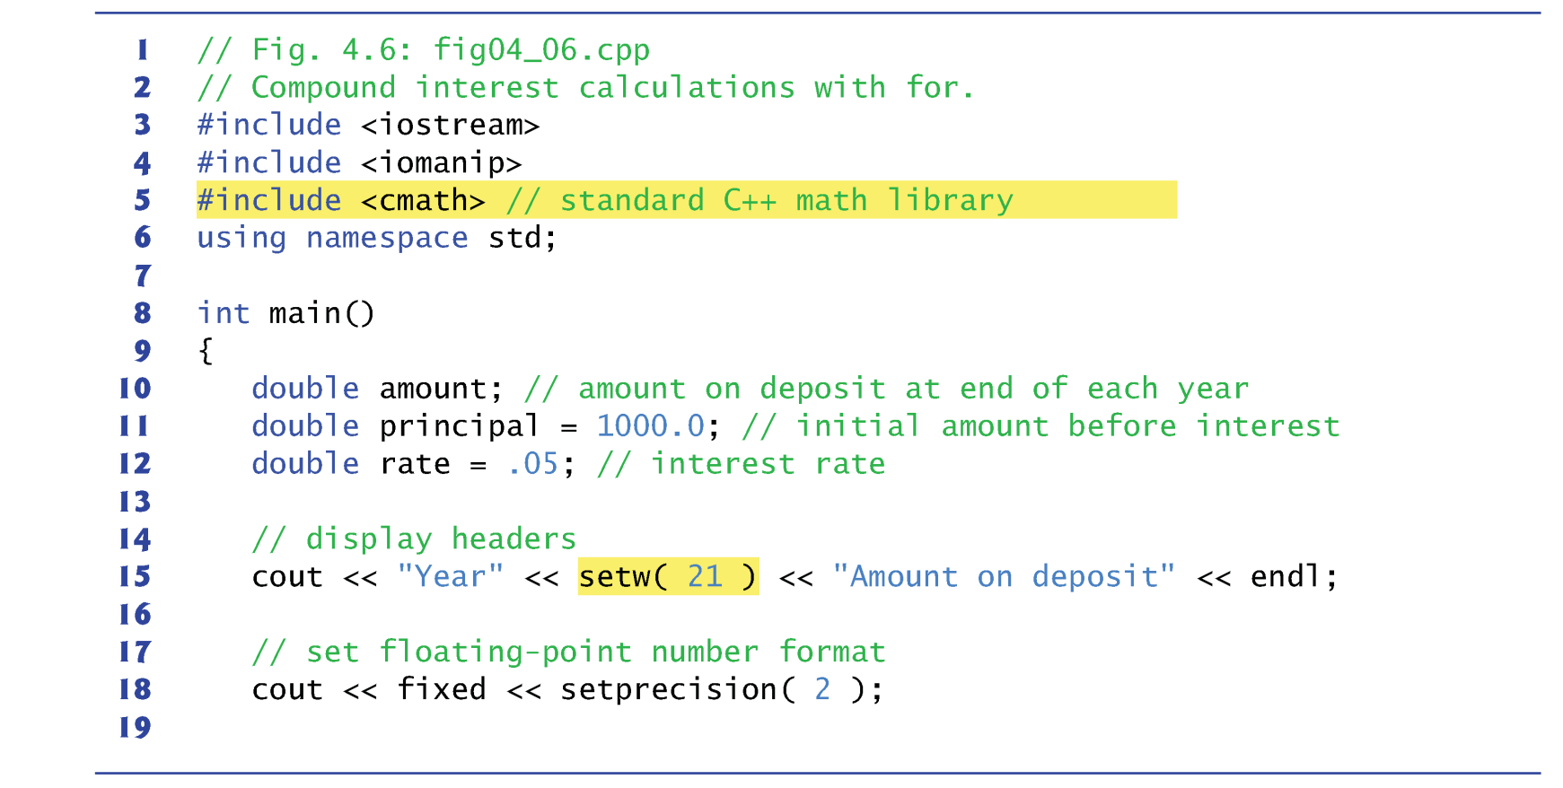
Example using for statement
Notes:
This is how the code looks. Here we have two new includes, iomanip and cmath. Iomanip stands for io manipulation and camath standards for c++ math library. Iomanip defines a bunch of very handy features for you to control the width and height of the output. For example, a lot of time you want to format your output with a fixed width, you use setw. Setw is a function that takes an integer number representing how much space characters you want for formatting the next string. In this example, here I use setw(21), that means I want to use 21 space characters for the next string. And the next string is “amount on depost”, and how many characters does it have? …
Fixed is an object defined in the iomanip library. It tells the program how much precision you need for printing a number, in this case, I only care up to two floating points. In this case, …

Slide 17
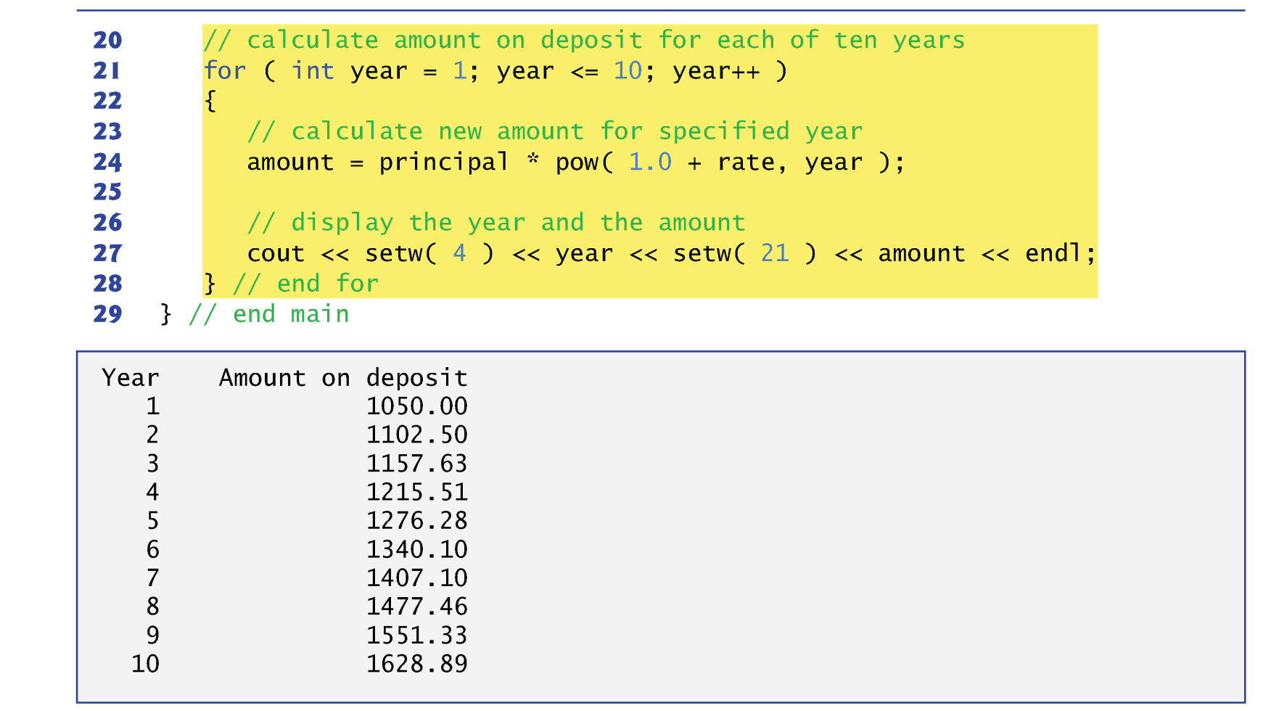
Example using for statement

Slide 18
Example using for statement
C++ does not include an exponentiation operator, so we use the standard library function pow.
pow(x, y) calculates the value of x raised to the y^{th} power.
Takes two arguments of type double and returns a double value.
This program will not compile without including header file <cmath>.
Includes information that tells the compiler to convert the value of year to a temporary double representation before calling the function.
Contained in pow’s function prototype.
Notes:
There are a couple of things we learn from this example.

Slide 19
Example using for statement
The stream manipulator setw(4) specifies that the next value output should appear in a field width of 4.
If less than 4 character positions wide, the value is right justified in the field by default.
If more than 4 character positions wide, the field width is extended to accommodate the entire value.
To indicate that values should be output left justified, simply output nonparameterized stream manipulator left .
Right justification can be restored by outputting nonparameterized stream manipulator right.
Notes:
The other thing we learned is the stream manipulator.

Slide 20
Example using for statement
Stream manipulator fixed indicates that floating-point values should be output as fixed-point values with decimal points.
Stream manipulator setprecision specifies the number of digits to the right of the decimal point.
Stream manipulators fixed and setprecision remain in effect until they’re changed—such settings are called sticky settings.
The field width specified with setw applies only to the next value output.

Slide 21
do…while Repetition Statement
Similar to the while statement.
The do…while statement tests the loop-continuation condition after the loop body executes
The loop body always executes at least once.
It’s not necessary to use braces in the do…while statement if there is only one statement in the body.
Most programmers include the braces to avoid confusion between the while and do…while statements.
Must end a do…while statement with a semicolon.
Notes:
Next topic, we are going to finish the last repetition statement in this course. That is do…while repetition statement. A do…while repetition is very similar to the while statement. The do…while statement tests the loop-continuation condition after the loop body executes. The key difference from a while statement is the loop body of do…while always executes at least once. (…)

Slide 22
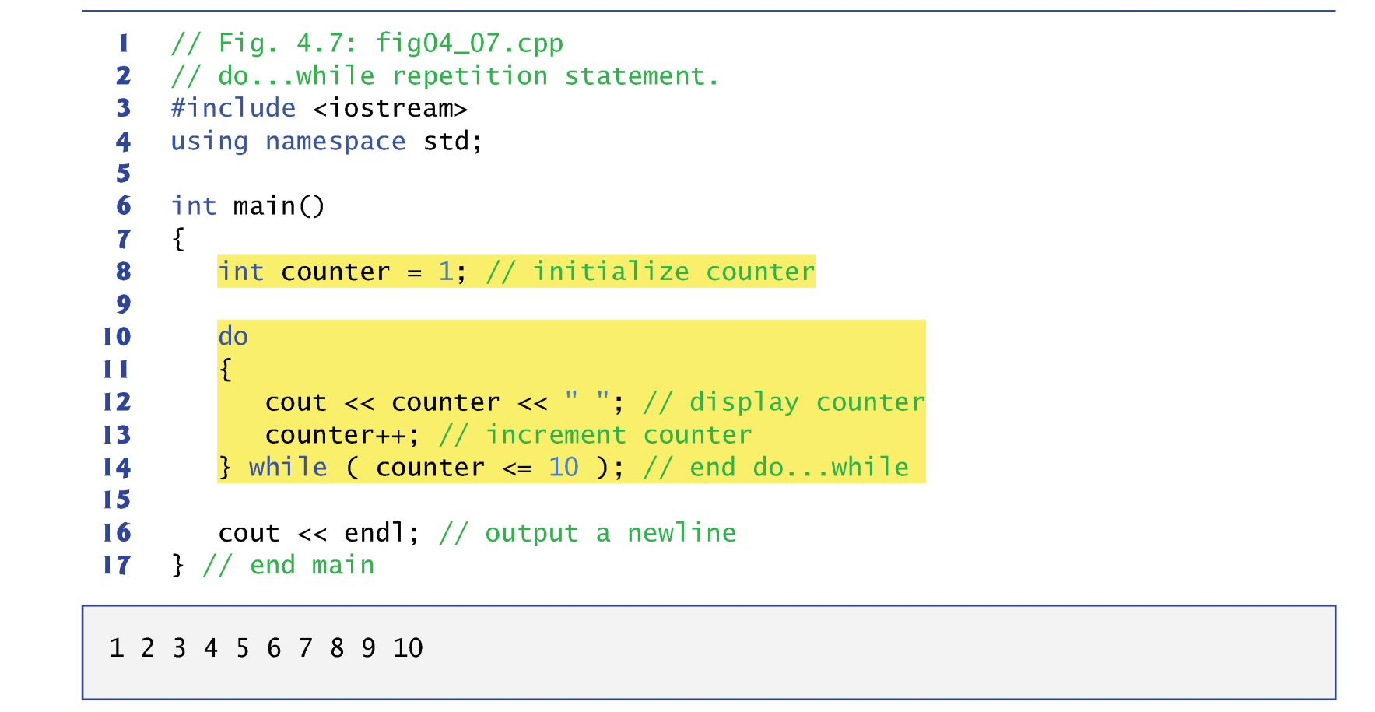
do…while Repetition Statement

Slide 23
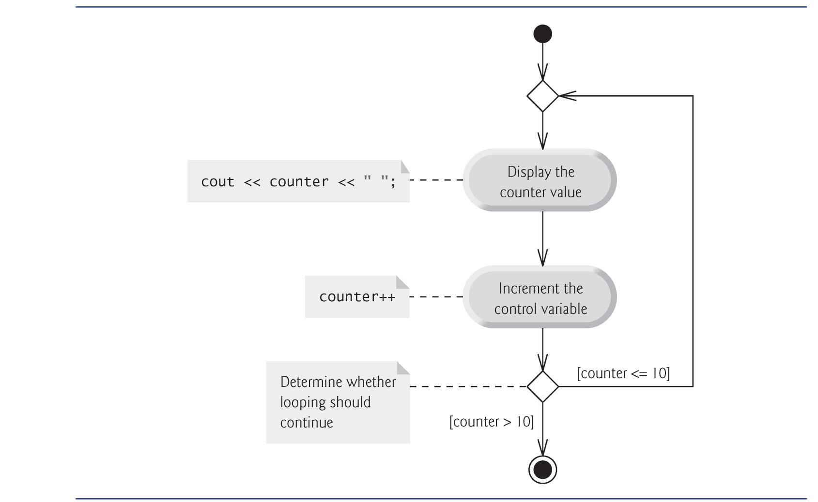
do…while Repetition Statement

Slide 24
do…while Repetition Statement
while vs. do…while
total = 0; grade = 0;
cout << “Enter grade, ”;
cout << “-1 to end: ”;
cin >> grade;
while (grade != -1) {
total = total + grade;
cout << “Enter grade, ”;
cout << “-1 to end: ”;
cin >> grade;
}
Duplicate input statements !!
Initial values are all zero.
total = 0; grade = 0;
do {
total = total + grade;
cout << “Enter grade, ”;
cout << “-1 to end: ”;
cin >> grade;
} While (grade != -1);
No duplicate input statements !!
Initial counter starts from -1.
Notes:
Now, we know while and do…while are similar to each other. What are the scenarios we use each of them? When do we use while and when do we use do…while? Well, the short answer to this is, if you know something in the repetition is definitely going to happen once, you use do…while, or while statement because while statement examines the condition first before executing anything, just like for loop. For example,

Slide 25
Summary
while loop statement
do...while loop statement
for loop statement

Slide 26
LAB: Iteration
Work as a group to write a program that
Asks user to give an input size N followed by N integer numbers
Performs iterations to find the maximum and the minimum number of these N integers
Version 1: for-loop
Version 2: while-loop
Decide one person to present your solution
Check in your attendance here (mark ‘Y’): https://docs.google.com/spreadsheets/d/1-UcFXgP9A3SDcwU_f5XxV68YFjVbHQeYIMI3m8mGtkI/edit#gid=0

